Slide 1
Creating a Mars Target Encyclopedia by Extracting Information from the Planetary Science Literature
Kiri L. Wagstaff (Jet Propulsion Laboratory), Ellen Riloff (University of Utah), Nina L. Lanza (Los Alamos National Laboratory), Chris A. Mattmann (JPL), and Paul M. Ramirez (JPL)
AAAI Knowledge Extraction from Text Workshop
February 12, 2016

Slide 2
Collect data
Uplink commands
Downlink data
Notes:
Need for an MTE

Slide 3
Mars surface targets

Slide 4

Opportunity Data Archive
MER: 4M Pancam, 1.7M Navcam, 230K MI
4200+ per-sol summaries of data collected
What have we learned about these targets?
“round-trip” tracking of data products and targets
…

Slide 5
Vision: A Mars Target Encyclopedia

Slide 6
Searchable interface

Slide 7
From text to knowledge
Manual composition annotations

Slide 8
From text to knowledge
Manual composition annotations
MTDB

Slide 9
From text to knowledge
Manual composition annotations
MTDB

Slide 10
The corpus
LPSC 2015 abstracts (n=1987)
Parsed PDFs using Apache Tika
# words parsed per document: 142 to 2433
Target list from MSL ChemCam (n=656)
Crest
Epworth
Goulburn
Link
…
Image credit: Commissariat a l'Energie Atomique (CEA)

Slide 11
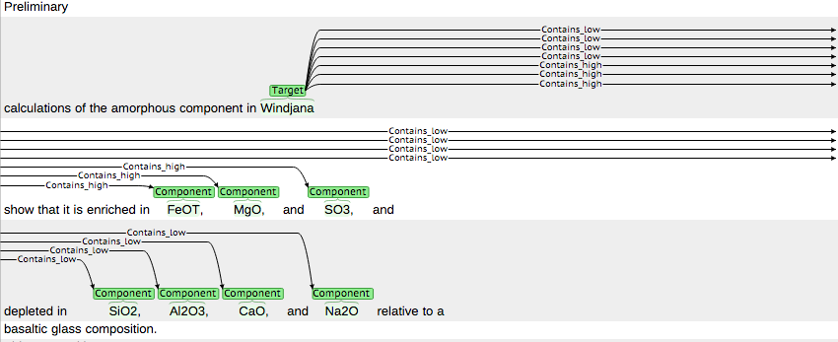
Manual composition annotations
brat: interactive annotation and visualization
Python script to import to PostgreSQL DB (MTDB)

Slide 12
Initial results
LPSC 2015
1438
Dillinger
Dillinger contains low Na/K ratio (doc 1438)
Dillinger contains illite clays (doc 1438)
Dillinger contains K-feldspar (doc 1438)
Dillinger contains high K (doc 1438)
Dillinger contains fluorine (doc 1989)
Dillinger contains pyroxene (doc 2038)
Dillinger contains K-feldspar (doc 2038)
Dillinger contains magnetite (doc 2038)
Dillinger contains phyllosilicate (doc 2038)
1989
Mars Target Database (MTDB)
2038
2620
2893
Notes:
Target composition and fact provenance

Slide 13
Initial results
LPSC 2015
1438
Dillinger
Dillinger contains low Na/K ratio (doc 1438)
Dillinger contains illite clays (doc 1438)
Dillinger contains K-feldspar (doc 1438)
Dillinger contains high K (doc 1438)
Dillinger contains fluorine (doc 1989)
Dillinger contains pyroxene (doc 2038)
Dillinger contains K-feldspar (doc 2038)
Dillinger contains magnetite (doc 2038)
Dillinger contains phyllosilicate (doc 2038)
1989
Mars Target Database (MTDB)
2038
2620
2893
Notes:
Target composition and fact provenance,
primary vs. secondary references

Slide 14
Automating text to knowledge
MTDB

Slide 15
Automated annotation
(Riloff, 1996)

Slide 16
Information extraction
Tika: PDF -> text
Sundance: text -> shallow parse
Autoslog: parse + target list -> patterns
Autoslog-TS: relevant + irrelevant docs -> prune patterns to increase precision

Slide 17
Initial automated results (Windjana)
“The Windjana sandstone contains high magnetite along with 2:1 phyllosilicates [9].”
<subj> CONTAINS MAGNETITE
“The high abundances of K-feldspar and iron oxides in Windjana, also reflected in the APXS chemical analysis as high K and Fe (Table 2) [7], are unusual.”
ABUNDANCE OF <np>
OXIDES IN <subj>
“Windjana is remarkable in containing an abundance of potassium feldspar (and thus K in its bulk chemistry) combined with a low abundance of plagioclase (and low Na/K in its chemistry).”
<subj> CONTAINING ABUNDANCE
ABUNDANCE OF <np>

Slide 18
Initial automated results (Windjana)
Synthesized:
Windjana
Windjana contains abundance of potassium feldspar
Windjana contains high abundances of K-feldspar and iron oxides
Windjana contains high magnetite
Windjana contains illite

Slide 19
Open questions
How to combine extractions into coherent entry? (information fusion)
Multi-source IE: papers can disagree, be superseded
Detect and resolve contradictions
Handle coreference
How to handle “epistemic modifiers”
E.g. “probably”, “likely contain”, “potential presence of” (“hedging” language)

Slide 20
MTE benefits
Questions
Publications
Knowledge
Commands
Observations
Answer questions such as:
What is already known about target X?
Is there consensus about target X’s properties?
What other targets are like X?
What targets are most unusual?

